Slide 1
OR 610-PROJECT PRESENTATION ON Quora INSINCERE QUESTIONS CLASSIFICATION
Abhishek Shambhu

Slide 2
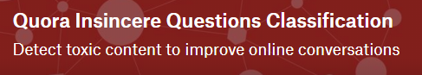

“
Quora helps you understand why the world works the way it does,
Why people behave the way they do …
GEORGE MASON UNIVERSITY

Slide 3
INTRODUCTION:
Quora is a platform for people to learn from each other. At Quora, people can ask questions and connect with others who offer unique insights and quality answers.
A key challenge is to weed out false questions - those that are based on false premises, or that are intended to make statements rather than seeking useful answers.
In this competition, our task is to do apply deep learning methods on natural language processing where the goal is to predict if a question’s intent is sincere.
GEORGE MASON UNIVERSITY

Slide 4
PROJECT OBJECTIVE:
The main aim of this project is to focus on the study of embeddings, how models work without pretrained embeddings and with pretrained embeddings such as GloVe embeddings, Paragram embeddings and Wikinews Fasttext embedding provided with the dataset.
Moreover, focuses the use of embeddings under two different deep learning models: Bidirectional GRU and LSTM.
Finally, comparing between different models and what can be done to improve the model evaluation metric F1 score.
GEORGE MASON UNIVERSITY

Slide 5
DATA DESCRIPTION:
An insincere problem is defined as a question that is intended to be a statement rather than a useful answer. Some features that indicate the problem of insincere:
Having a non-neutral tone:
- Having an exaggerated tone to underscore a point about a group of people.
Are disparaging or inflammatory:
- Suggest a discriminatory idea against a protected class of people, or seeks confirmation of a stereotype.
- Make disparaging attacks/insults against a specific person or group of people.
- Are Disparaging against a characteristic that is not fixable and not measurable.
Aren’t grounded in reality:
- Based on false information, or contains absurd assumptions.
- Using sexual content (incest, bestiality, pedophilia) for shock value, and not to seek genuine answers.
GEORGE MASON UNIVERSITY

Slide 6
DATA DESCRIPTION (Continued):
Random Sincere Questions:
(1) Can you make Amazon Alexa trigger events in the browser?
(2) How can I top CBSE in 6 months?
(3) Why do customs areas at airports not allow pictures?
(4) What are the weakest body parts when fighting?
(5) What are some best college for aircraft propulsion(M.S)?
Random Insincere Questions:
(1) Why do Chinese hate Donald Trump?
(2) Why will Jullie leave me?
(3) AreÂ JatÂ andÂ GujjarÂ girls beautiful?
(4) Why is Jinping the biggest serial religion murderer and rapist leader of the world after Mao?
(5) Why do so many women become so rude and arrogant when they get just a little bit of wealth and power?
Basically, any question who’s intent is to anger, offend or inflame and no information can be gained from such questions need to be excluded from Quora’s platform.
GEORGE MASON UNIVERSITY

Slide 7
DATA DESCRIPTION (Continued):
The training data includes the question that was asked, and whether it was identified as insincere (target=1). The ground-truth tag contains some noise: they are not guaranteed to be perfect.
Quora Train dataset shape: (1306122, 3), Quora Test dataset shape: (375806, 2)
DATA FIELDS:
Qid - unique question identifier
Question_text - Quora question text
Target - the value of the question labeled "insincere" is 1, otherwise 0
GEORGE MASON UNIVERSITY

Slide 8
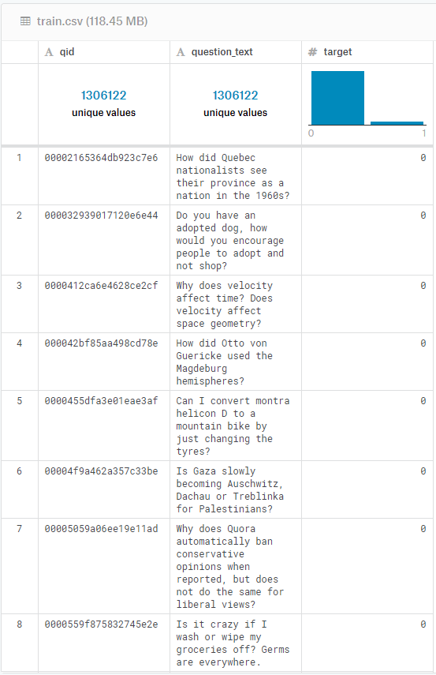
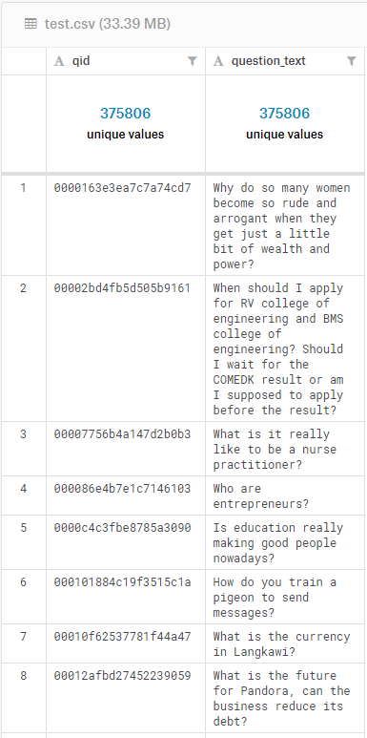
DATA DESCRIPTION (Continued) :
GEORGE MASON UNIVERSITY

Slide 9
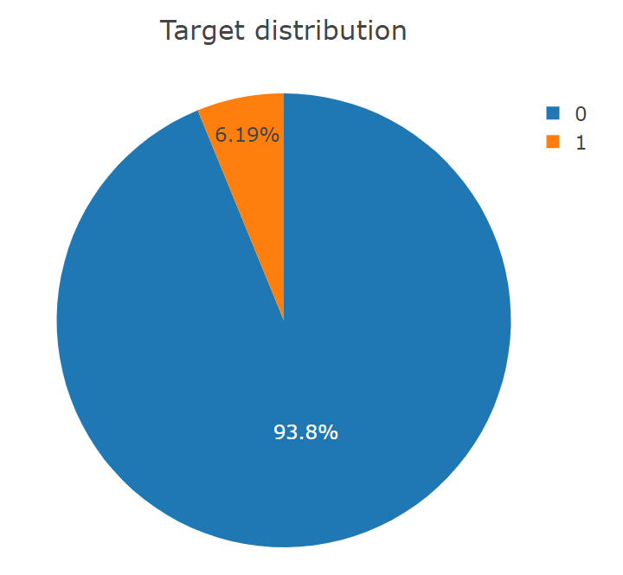
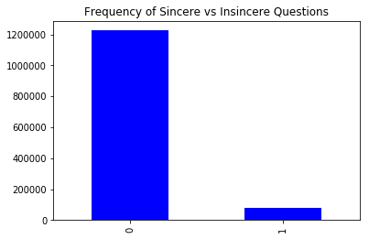
EXPECTED DIFFICULTIES (SINCERE/INSINCERE DISTRIBUTION FOR TRAINING DATA):
Difficulties:
Large Dataset
The training data has over 1.3 million records. So, we expected challenges in dealing with the large dataset.
Challenges may include running into memory errors and excessive processing times.
Imbalanced Dataset
The dataset is highly imbalanced, with only 6.19% of samples belonging to the target (insincere) class.
Solution:
To avoid excessive processing times, we used the Kaggle workspace which provides GPU compatibility.
Moreover, addition of ADAM Optimizer (also applied other optimizers but Adam was best) to models since optimization is also important.
And since it is an imbalanced dataset, we looked at the F1 score metric instead of accuracy to test our models.
1225312
80810
GEORGE MASON UNIVERSITY

Slide 10
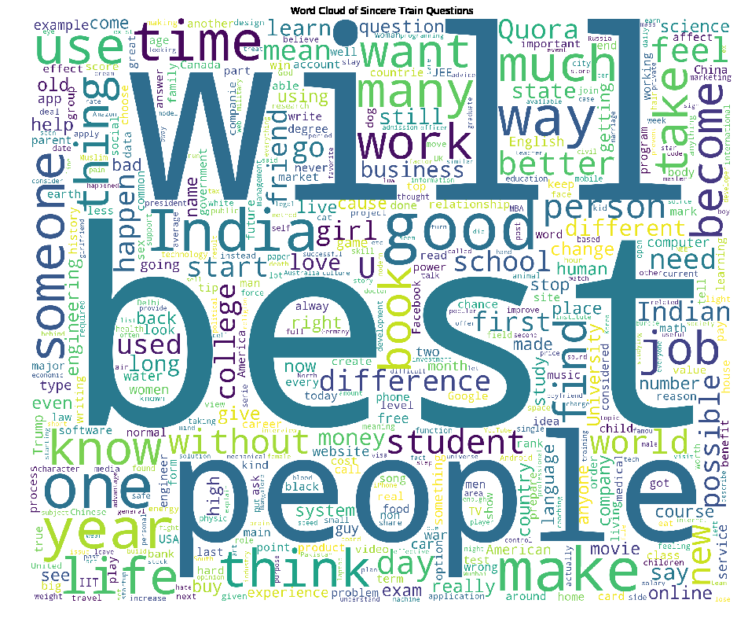
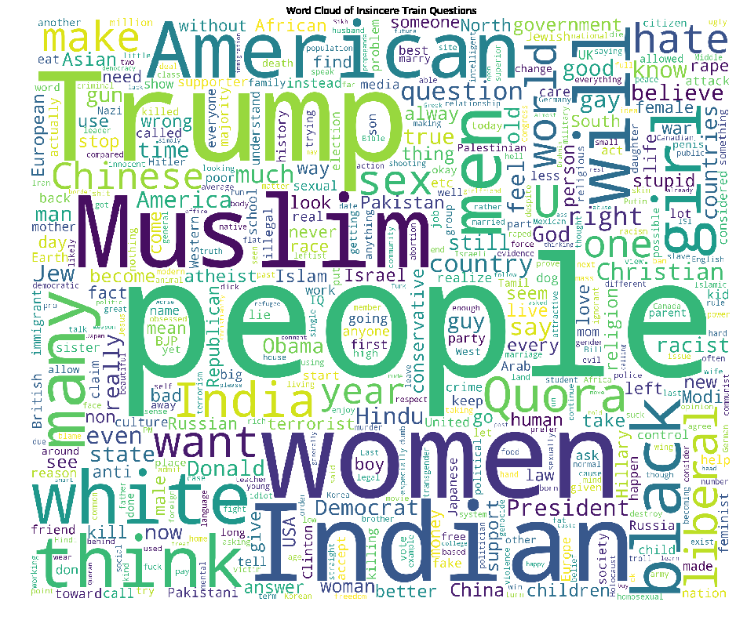
WORD CLOUD FOR SINCERE/INSINCERE QUESTIONS IN TRAIN DATASET:
Sincere Questions
Insincere Questions
GEORGE MASON UNIVERSITY

Slide 11
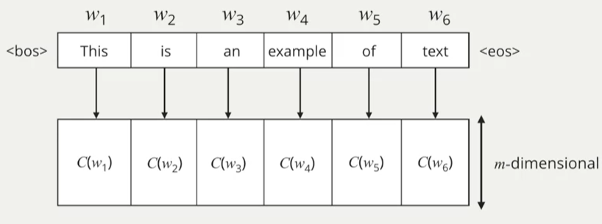
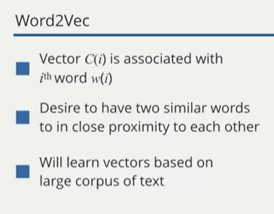
WORD EMBEDDING
Word embedding are mappings from words to d-dimensional vectors
Examples of Word2Vec embeddings are – GloVe, fastText, Starspace, RAND-WALK and more…
GEORGE MASON UNIVERSITY
Notes:
Actual numbers of these words are from the skip-gram model.

Slide 12
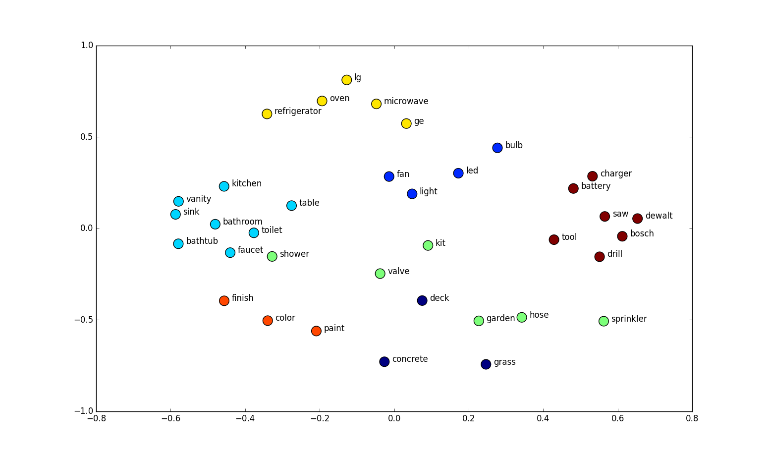
A look at Vector space of words
Why do we need and how word2vec mapping is done?
Text is not computable
So, we give a numerical representation to give the power of computation for the text data
Idea is that when words are similar or related to each other, they should be closer to each other in the vector space and far apart when they are dissimilar.
Each word is mapped to a point in 2D space.
GEORGE MASON UNIVERSITY

Slide 13
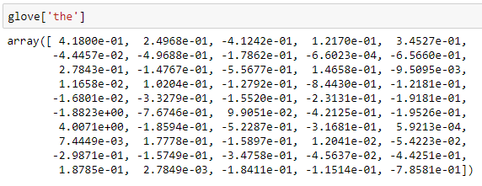
Example: GloVe - Global Vectors
GloVe is unsupervised learning algorithm for obtaining vector representations for words
It is co-occurrence matrix approach
Given a corpus, build a co-occurrence matrix of the words in the vocabulary in a given context size.
By minimizing the objective function we get our word embeddings
GEORGE MASON UNIVERSITY
Notes:
Word the is mapped of this kind of vector using glove

Slide 14
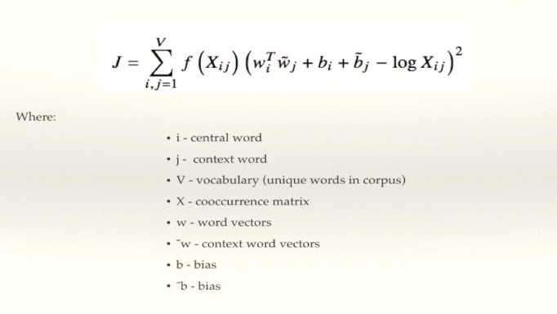
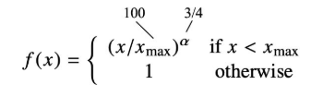
GloVe notation
GEORGE MASON UNIVERSITY
Notes:
Xij is number of times word i appears in context of j
Smoothing out frequent words with function(x) which essentially suppressing stop words on the training set
For all words in the vocabulary we take sum of the weighted function f(Xij) times of square of product of central and context word plus bias – log Xij

Slide 15
GloVe
Different variants of GloVe embedding:
Common Crawl (42B tokens, 1.9M vocab, uncased, 300d vectors, 1.75 GB download): glove.42B.300d.zip
Common Crawl (840B tokens, 2.2M vocab, cased, 300d vectors, 2.03 GB download): glove.840B.300d.zip
Wikipedia 2014 + Gigaword 5 (6B tokens, 400K vocab, uncased, 300d vectors, 822 MB download): glove.6B.zip
Twitter (2B tweets, 27B tokens, 1.2M vocab, uncased, 200d vectors, 1.42 GB download): glove.twitter.27B.zip
GEORGE MASON UNIVERSITY

Slide 16
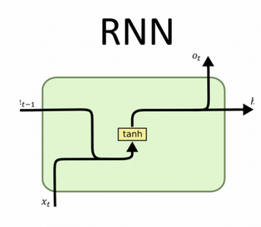
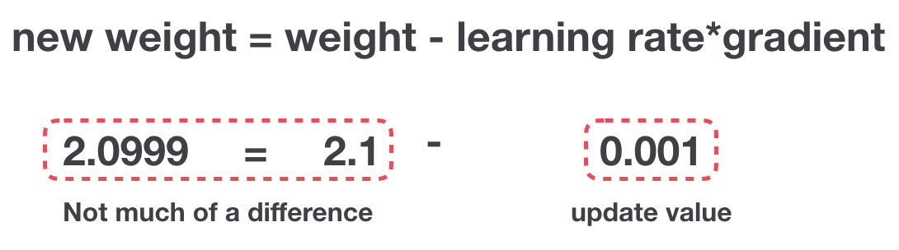
MODELING:
INTUITION BEHIND GRU & LSTM?
The Problem, Short-Term Memory
RNN suffer from short-term memory.
Difficult to carry information from earlier time steps to later ones.
Example: Paragraph like questions
Vanishing Gradient Problem during Back propagation
Gradient shrinks as it back propagates through time.
If a gradient value becomes extremely small, it doesn’t contribute and stops learning and thus having a short-term memory.
F1 score – 0.61
Gradient Update Rule
GEORGE MASON UNIVERSITY

Slide 17
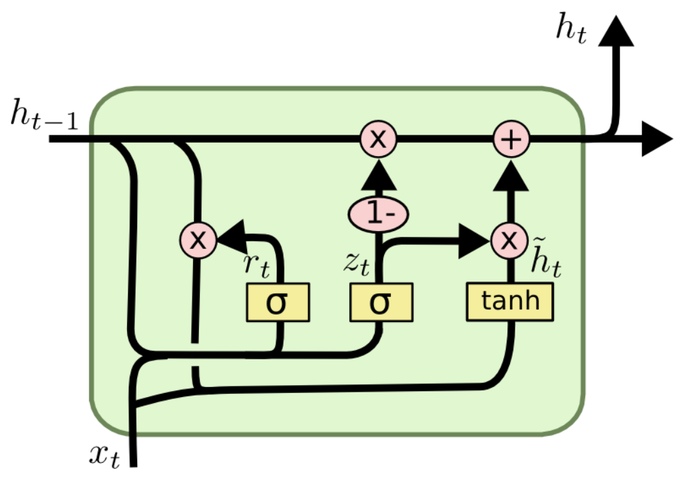
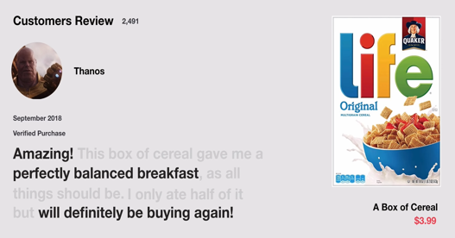
MODELING:
GRU
Internal mechanism called gates that regulate the flow of information.
Gates learn which data in a sequence is important to keep or throw away.
This will pass only the relevant information over the long chain of sequences to make predictions.
Update Gate: What information to throw away and what new information to add.
Reset Gate: How much past information to forget.
Reset Gate
Update Gate
GEORGE MASON UNIVERSITY

Slide 18
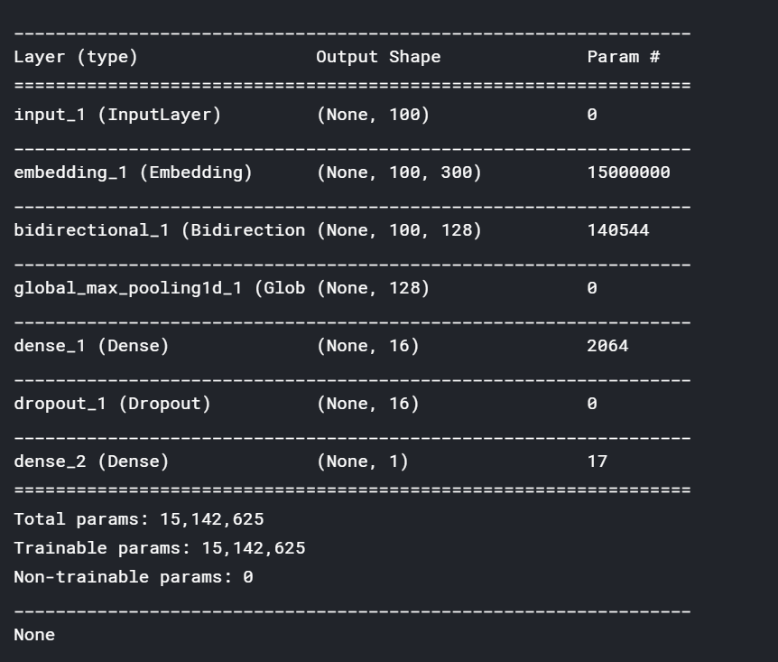
MODELING:
Input Layer (max seq length)
Model 1: Bidirectional GRU as a solution
The first model we experimented with is a RNN implementation in Keras utilizing a bidirectional GRU as its recurrent unit.
The entire model architecture is as follows:
Each input question/sentence is first cleaned, tokenized, and padded into a sequence of length 100.
We feed this to the model’s first layer, the embedding layer.
Next, a simple bidirectional GRU layer is used.
Finally, the rest of the network is filled out with fully connected, max pooling and dropout layers.
Embedding
Bidirectional GRU
Max pooling
Fully connected
Dropout
Fully connected
GEORGE MASON UNIVERSITY
Notes:
Dense layer – change the dimensions of vector / each neuron receives input from all the neurons in the previous layer
Input – matrix vector multiplication Output – m dim vector
Dropout layer – Activation is set to 0 for few random nodes / Regularization technique which reduces complexity
- this prevents overfitting

Slide 19
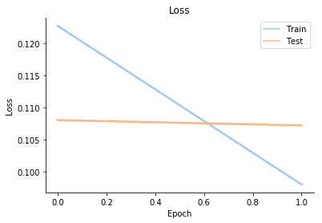
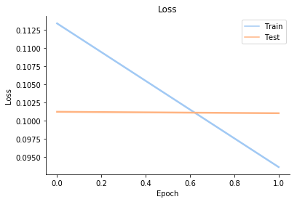
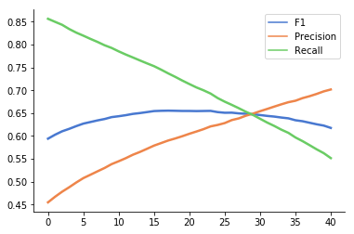
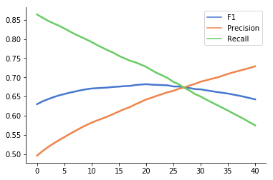
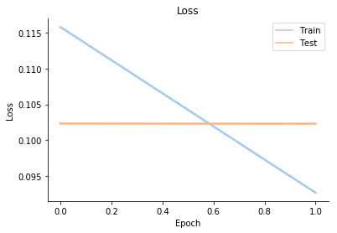
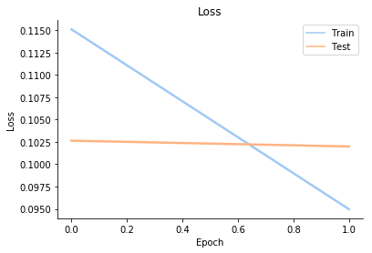
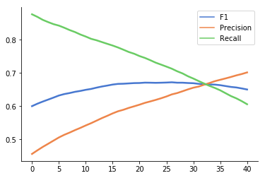
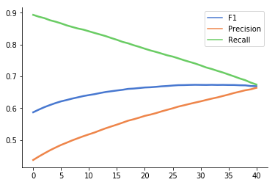
Bidirectional GRU:
Plot of Train/Test loss v/s Epoch
Plot of F1 score, Precision and Recall for different thresholds
Without Pretrained Embedding
GloVe Embedding
Without Pretrained Embedding
GloVe Embedding
F1 score: 0.6554
F1 score: 0.682
F1 score: 0.672
F1 score: 0.673
Wiki News Fast text Embedding
Paragram Embedding
Wiki News Fast text Embedding
Paragram Embedding
GEORGE MASON UNIVERSITY

Slide 20
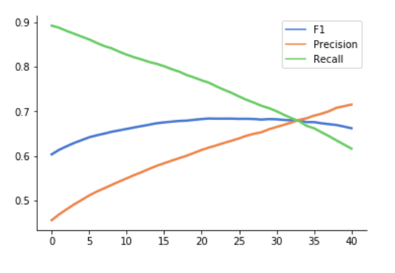
Bidirectional GRU:
Though the results of the GRU models with different pre-trained embeddings are similar, there is a good chance that they might capture different type of information from the data.
So, we did a blend of these three models by averaging their predictions.
We saw that, with a blend of multiple embeddings we got a higher F1 score of 0.684.
GEORGE MASON UNIVERSITY

Slide 21
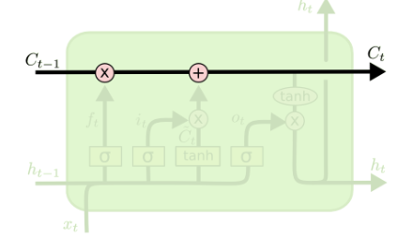
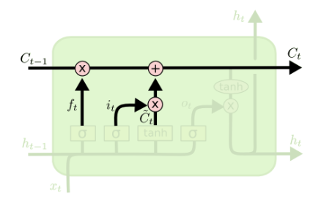
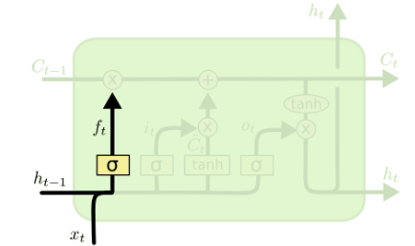
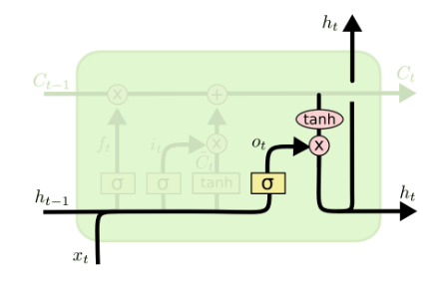
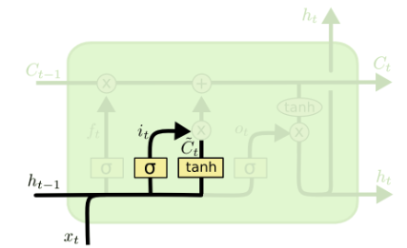
LSTM
A variant of RNN introduced by Hochreiter & Schmidhuber (1997)
Capable of learning long-term dependencies as a solution to the problem that RNNs become unable to learn to connect the information where gap between the relevant information and the point where it is needed become very large
LSTM’s ability to forget, remember and update the information pushes it one step ahead of RNNs
The key to LSTMs is the cell state that persists the information without changing
The LSTM adds/removes information to the cell state regulated by structures called gates.
Source: colah's blog
GEORGE MASON UNIVERSITY

Slide 22
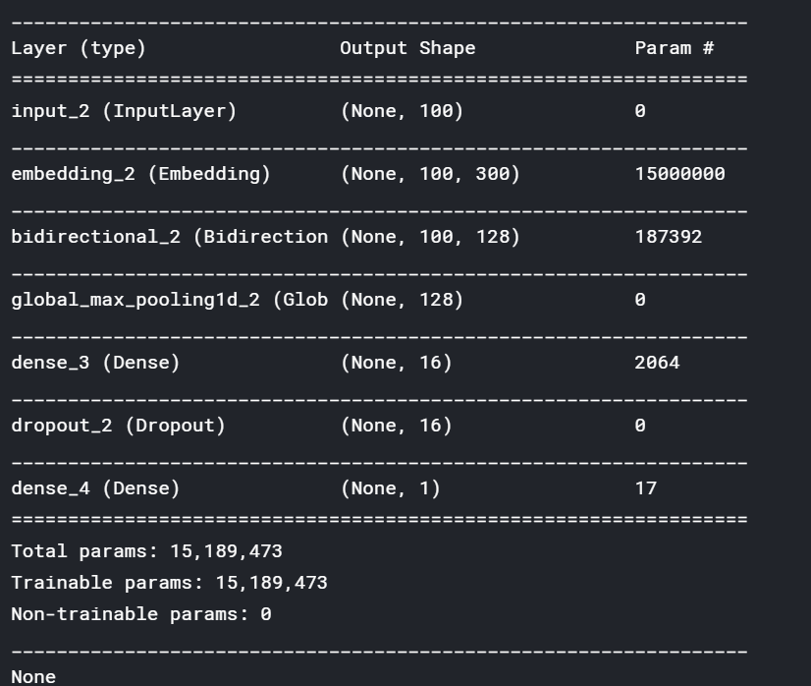
Bi directional LSTM
Bidirectional LSTMs are an extension of traditional LSTMs
In addition to LSTM’s preserving information from the past, BiLSTM preserve information from both past and future.
Improve model performance by understanding the context better on very complicated questions
Bidirectional LSTMs train two instead of one LSTM on the input sequence/text
The first LSTM on the input sequence as-is and the second on a reversed copy of the input sequence
This provide additional context to the network and result in faster and fully learning the problem
GEORGE MASON UNIVERSITY

Slide 23
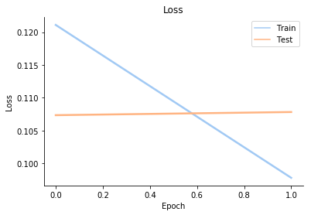
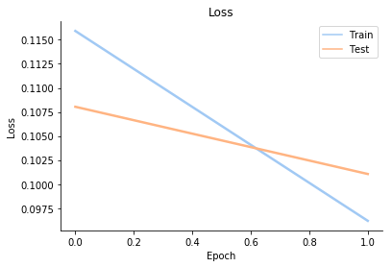
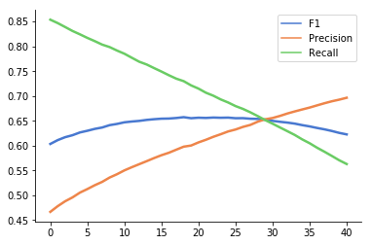
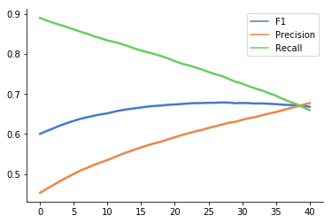
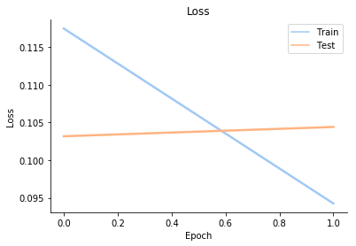
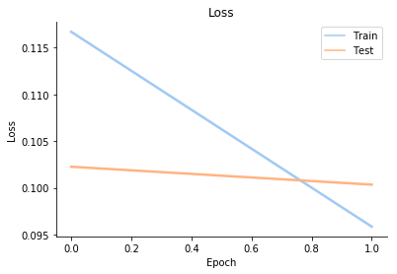
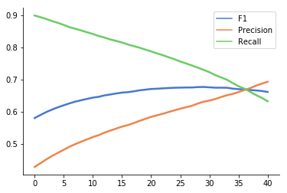
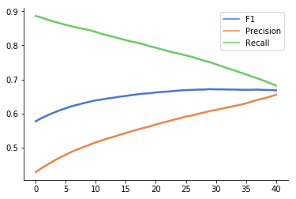
Bidirectional LSTM:
Plot of Train/Test loss v/s Epoch
Plot of F1 score, Precision and Recall for different thresholds
Without Pretrained Embedding
GloVe Embedding
Without Pretrained Embedding
GloVe Embedding
F1 score: 0.655
F1 score: 0.679
F1 score: 0.671
F1 score: 0.676
Wiki News Fast text Embedding
Paragram Embedding
Paragram Embedding
Wiki News Fast text Embedding
GEORGE MASON UNIVERSITY

Slide 24
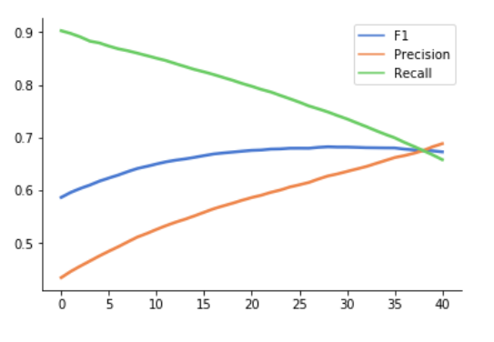
Bidirectional LSTM:
Inspired from the better performance of aggregated GRU predictions
So, we did a blend of these three models by averaging their predictions.
We saw that, with a blend of multiple embeddings we got a higher F1 score of 0.683.
GEORGE MASON UNIVERSITY

Slide 25
Parameters & hyperparameters:
Neurons | 64*2
Hidden Layers | 6 (varies per model)
Epochs | 2
Learning Rate | 0.001
Max features of embeddings | 50000
Embedding size | 300
Dropout rate | 0.1
GEORGE MASON UNIVERSITY

Slide 26
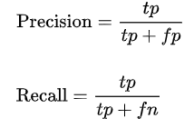
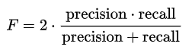
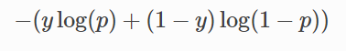
Model compilation
F1-Score
------------------------------------------------
F1-Score considers both the precision p and the recall r of the test to compute the score which is why it is a better metric than accuracy
Loss : Crossentropy
optimizer : Adam
Metrics : F1-Score
Cross Entropy loss:
-------------------------------------------------
In binary classification, where the number of classes equals 2
It measures the performance of a classification model whose output is a probability value between 0 and 1. Cross-entropy loss increases as the predicted probability diverges from the actual label.
Adam Optimizer
-------------------------------------------------------
Adam is an adaptive learning rate method, which means, it computes individual learning rates for different parameters.
It is a combination of RMSProp and SGD
GEORGE MASON UNIVERSITY

Slide 27
Results and comparison
 | Model | Train loss | Validation loss | F1 score
Without Pretrained Embeddings | Bidirectional GRU model | 0.0981 | 0.1072 | 0.655
 | Bidirectional LSTM model | 0.0978 | 0.1078 | 0.657
Glove Embeddings | Bidirectional GRU model | 0.0936 | 0.1010 | 0.682
 | Bidirectional LSTM model | 0.0962 | 0.1011 | 0.679
Paragram Embeddings | Bidirectional GRU model | 0.0950 | 0.1020 | 0.673
 | Bidirectional LSTM model | 0.0959 | 0.1003 | 0.676
Wiki News FastText Embeddings | Bidirectional GRU model | 0.0926 | 0.1023 | 0.672
 | Bidirectional LSTM model | 0.0943 | 0.1044 | 0.671
Bidirectional GRU with all the embeddings – F1 score 0.684
Bidirectional LSTM with all the embeddings – F1 score 0.683
Kaggle Competition winner – F1 score 0.71
GEORGE MASON UNIVERSITY

Slide 28
Conclusion & Future Scope:
Deep learning models were efficiently able to classify the model.
Pretrained word Embeddings helped in understanding the context better thereby gave a better accuracy over the baseline models.
GRU model with GloVe word embedding gave a better f1-score compared to other individual models.
Final predictions that were obtained after averaging the predictions of all embeddings for both the models GRU and LSTM is approximately the same. However, it is better than each of the individual embedding applied to the dataset.
There is still room for improvement by performing NLP pre-processing, tuning the parameters such as choosing wider range of learning rate, more number of epochs and also adding more layers such as attention layer, CapsNet etc. which would definitely improve our models.
GEORGE MASON UNIVERSITY

Slide 29
Thank You
GEORGE MASON UNIVERSITY

